Slide 1
CNN with AE
Ajou Univ. software dep. 201920723 김동욱
Kim Dong Wook

Slide 2
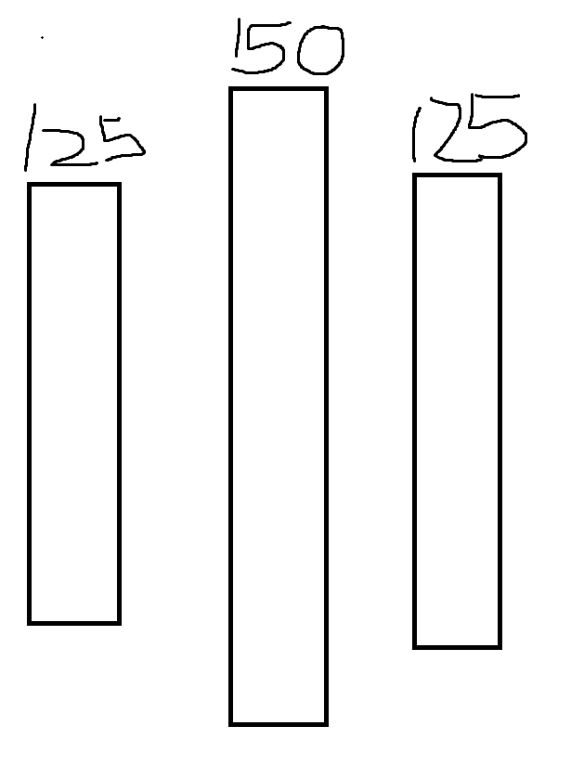
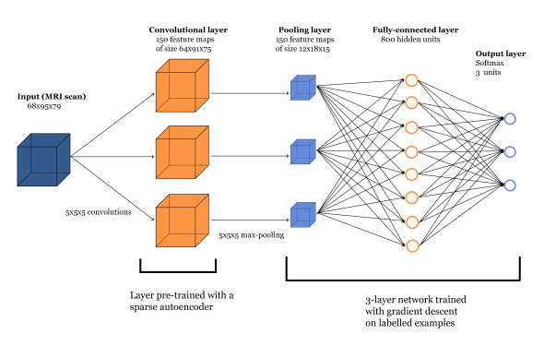
model
Used CNN pre-trained with sparse autoencoder

Slide 3


loss

Slide 4
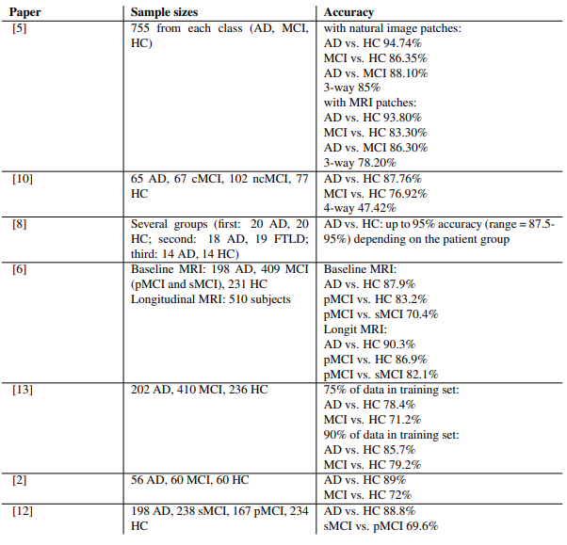
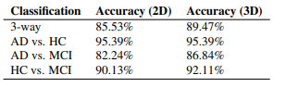
conclusion

Slide 5
paper
CNN with pre-trained filters with autoencoder : https://arxiv.org/pdf/1502.02506.pdf

Slide 6
note
Didn’t just used CNN for classification but used autoencoder to learn filters.

Slide 7
keyword
Autoencoder

